Slide 1
TORi - Personal Voice Assistant

Slide 2
Team Members:
Vaibhavi Kadam
Aditya Raut
Mihir Mitkari
Our Guide:
Prof. Sandip Chavan

Slide 3
Properties of Laptop Assistant
Voice or speaker recognition is the ability of a machine or program to receive and interpret dictation or to understand and carry out spoken commands. Voice recognition has gained prominence and use with the rise of AI and intelligent assistants
The first step of the process is to understand the speech of the speaker. The sound waves generated by the speaker need to be interpreted and analysed to break them down into fractions of text.
Voice recognition is commonly used to operate a device, perform commands, or write without having to use a keyboard, mouse, or press any buttons

Slide 4
The Motivation behind this:
Our aim was to create a virtual assistant on our device which we could control from our voice. The fascination to use voice commands to do some basic stuff on our laptop drew us to create TORi

Slide 5
Problem Statement:
1
Quit all the hassle and simply use the Voice Assistant to control your laptop.

Slide 6
People are troubled by typing commands into the computer. Be it procrastination or a busy schedule. Typing is a big obsolete process. The solution to this is that we switch over to an assistant which understands us and do the initial work for us. An assistant is the best replacement for typing commands. Our Voice Assistant with Voice Recognition Intelligence, which takes the user input in form of user’s voice and processes it and return the output in various ways like an action to be performed or the search result is speaked out to the end user.

Slide 7
Literature survey and Limitations of Cortana.
about:
Intelligent voice assistants are internet-connected devices,which listen to their environment and react to spoken user commands in order to retrieve information from the internet, control household appliances, or notify the user of incoming,reminders etc. With their increasing ubiquity is smart homes,their application seems only limited to the imagination of the developers who connect these off-the-shelf devices to existing apps and online services
To justify the trust placed into the devices, the devices must be secure from unauthorized access and the back-end infrastructure tasked with speech-to-text analysis, command interpretation, and connection to other services and appliances must maintain confidentiality of data

Slide 8
Limitations of cortona:
It runs in the background of your laptop causing it to slow down your device in the long run.Various reports were suggested that it posed a security threat to its users. If you choose to keep it running in the background, you will face battery drainage in no time. As it is not linked to Google directly, not everyone is comfortable using it.
cortona

Slide 9
TORi-Voice Assistant TORi is internet-connected softwate,which listen to their environment and react to spoken user commands in order to retrieve information from the internet, control our laptops and perform some basic tasks.

Slide 10
System Design The model consists of user input through microphone to accept commands from the user. These commands are then go through Speech Recognition, it is the ability of a machine or program to identify words and phrases in spoken languages and convert them to a machine.

Slide 11
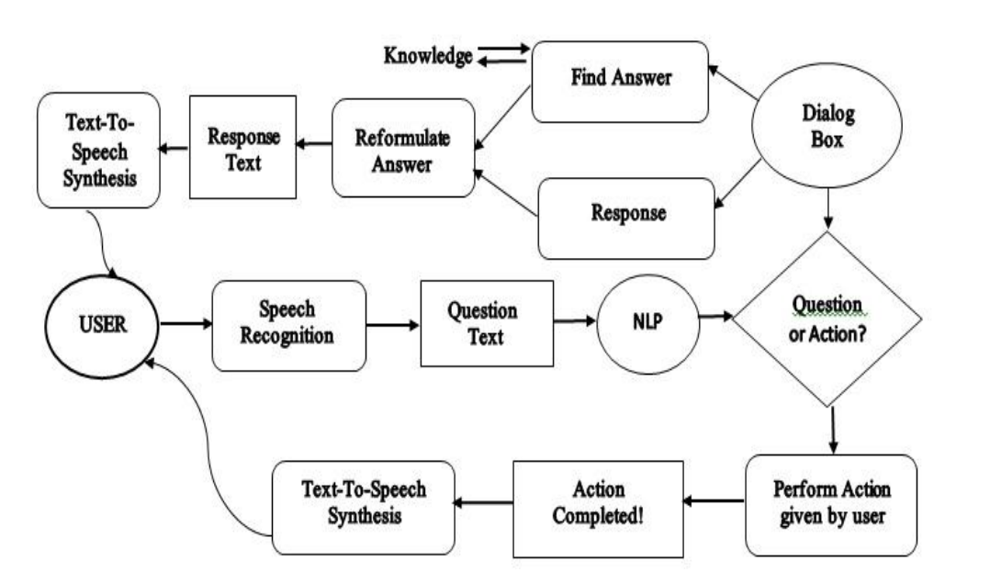
System Architecture

Slide 12
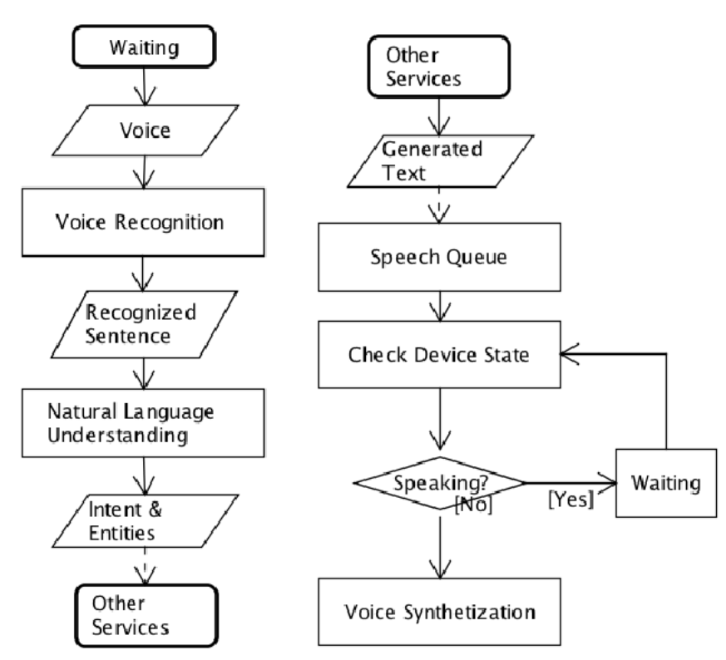
Algorithm

Slide 13
Architecture & Framework
The following tools were used to make TORi:
COMMAND PROMPT ( CMD)
VISUAL STUDIO CODE
PYTHON PROGRAMMING LANGUAGE
QT DESIGNER
SPYDER( ANACONDA 3)
ML TO BE USED LATER

Slide 14
Command Prompt Usage
USAGE OF CMD
CMD USED TO INSTALL LIBRARIES.
USED TO CONVERT .ui FILE TO .py FILE.

Slide 15
Command for converting .ui to .py file:
Pyuic5 -x fileName .ui -o fileName .py
Command for converting .py to .exe
Pyinstaller __onefile filename.py
.exe file is required when taken into consideration,not every user will have all the python libraries installed on their system.

Slide 16
VS CODE USAGE
VISUAL STUDIO
We used extensions of voice assistant which allowed us to write codes with voice commands.
After installing extension,installing server is necessary because it does the voice recognition job.
An example of a screen grab of a code from vs code will be shared on the next slide.

Slide 17
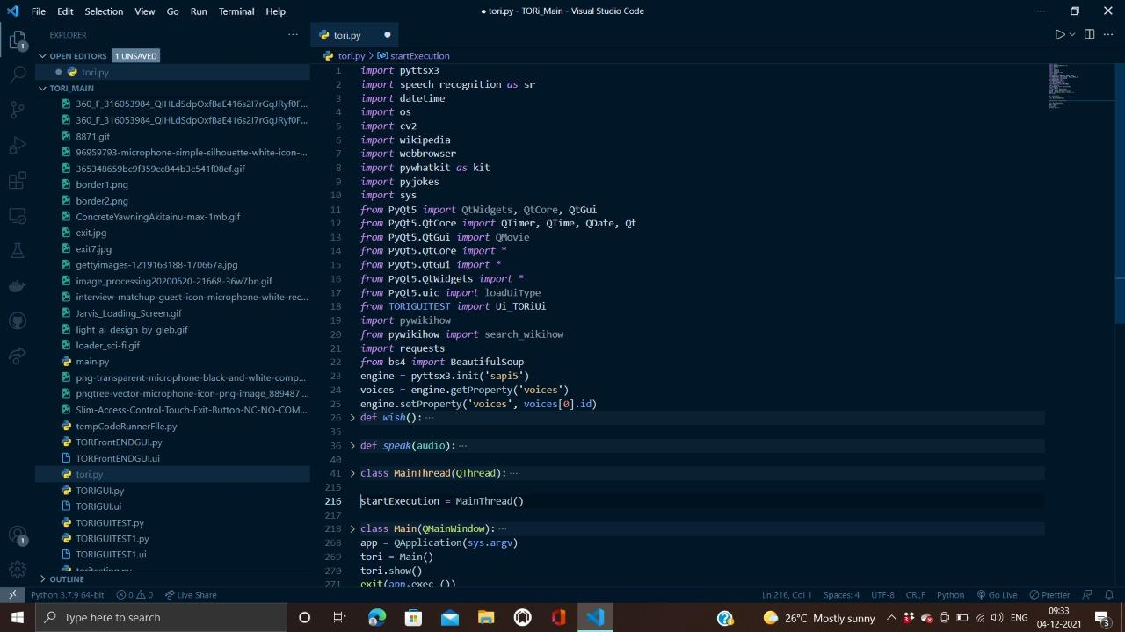
Code Screen grab

Slide 18
QT designer
Qt Designer is the Qt tool for designing and building graphical user interfaces (GUIs) with Qt widgets .
Widgets and forms created with Qt Designer integrate seamlessly with programmed code, using Qt's signals and slots mechanism.
It enables a completely customizable appearance, touch-reactive elements, and smooth animated transitions, backed up by the power of OpenGL graphics acceleration.

Slide 19
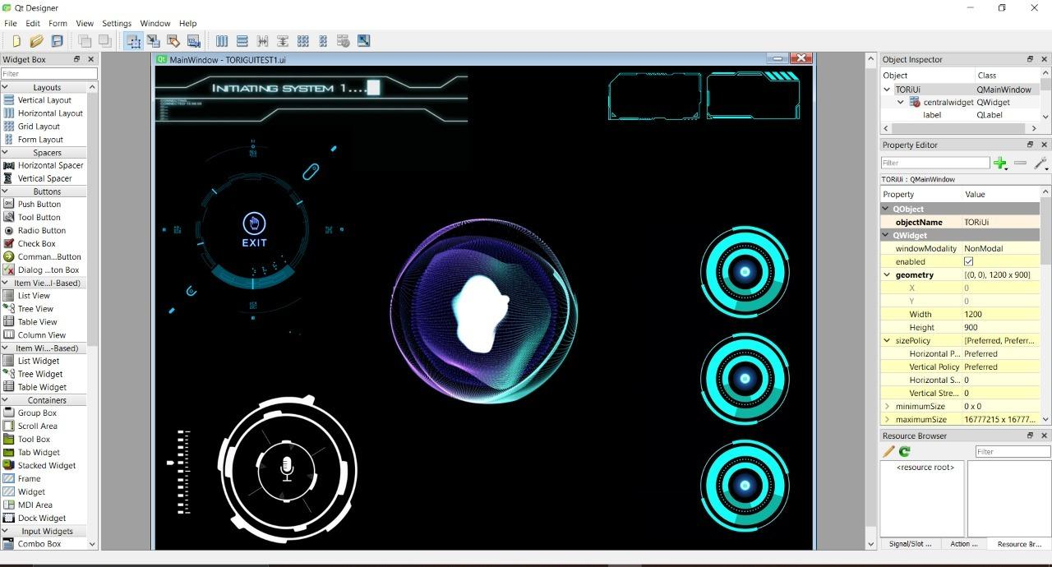
GUI screen grab
STRENGTHS
Blue is the colour of the clear sky and the deep sea
WEAKNESSES
Yellow is the color of gold, butter and ripe lemons
S
W
Black is the color of ebony and of outer space
OPPORTUNITIES
White is the color of milk and fresh snow
THREATS
O
T

Slide 20
Our Future Work.
The future goal is to empower the differently abled community with the task being to create a virtual assistant to cater for their needs .
Using Hand Gestures to help them overcome their shortcomings and using only virtual gestures to help the ones who cannot speak are some of the avenues we want to venture into.
More Libraries to be added to support the aforesaid properties and improving our GUI with time.
With time as we unlock more resources and capabilities we will work to make this virtual assistant more advanced and useful. Tech Advancements and usage of Machine Learning(ML) and more advanced levels of Artificial Intelligence to improve our product.

Slide 21
Thanks!
For patient listening.

